Slide 1

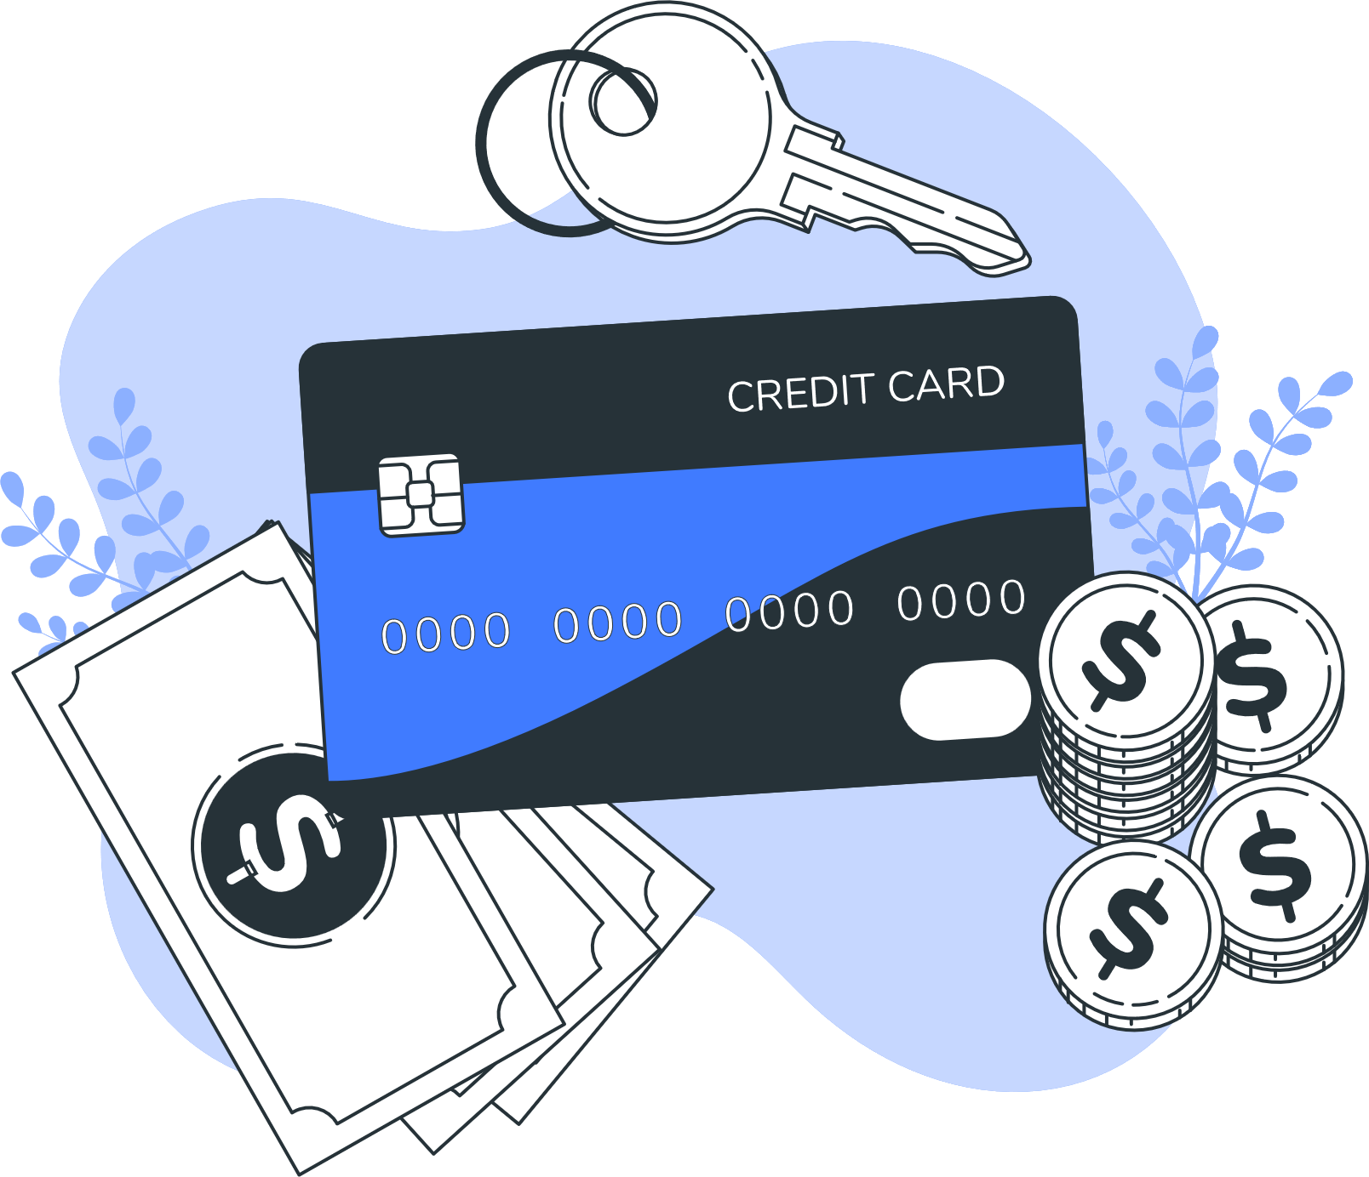
Credit Card Fraud Detection
BY
Ritik Kataria

Slide 2

Outline
Business Problem/Opportunity
Types of Frauds using Credit Cards
Background of Organization
Impact of the Fraud on the Banks/Economy
Data Description
Data Mining Problem
Methods
Evaluation
Recommendations
Potential Solutions

Slide 3
Business Problems
The problem is to accurately distinguish between legitimate and fraudulent transactions in real-time to prevent financial losses and maintain trust with customers.
It is difficult to analyze or detect fraud transactions without help of machine learning classifiers. This kernel helps to understand data with basic visualization and statistical methods.

Slide 4

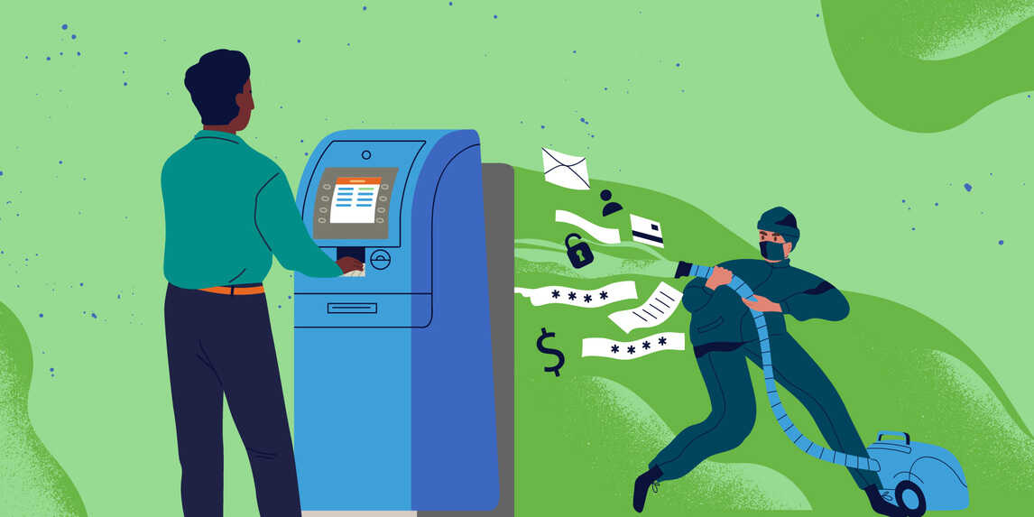
Types of Frauds Card Skimming Online Fraud Lost or Stolen Cards Identity Theft Account Takeover Phishing Attack Counterfeit Cards

Slide 5

Background of Organization
Credit card theft presents substantial challenges and hazards to financial institutions, affecting their financial stability, operational efficiency, reputation, and regulatory compliance. Implementing strong fraud detection and prevention techniques is critical to reducing these risks and protecting both the firm and its customers.
How to deal with it….
Financial institutions use sophisticated algorithms and machine learning models to examine transaction patterns and identify odd or suspicious conduct. These technologies can detect possibly fraudulent transactions and flag them for further investigation.

Slide 6

Impact of the Frauds
Financial Impact: Credit card fraud causes significant financial losses for banks and individuals through reimbursement costs, investigation expenses, and credit score damage.
Trust and Reputation: Fraud undermines trust in financial institutions, leading to reputational damage and potential customer churn, impacting long-term loyalty and market share.
Economic Consequences: Credit card fraud lowers consumer confidence, reducing spending and economic activity. Costs of prevention measures divert resources, while higher prices affect purchasing power, hindering economic growth.

Slide 7
Data Description
We used a primary dataset which consist of transactions made by cardholders through various credit cards.
We used a secondary dataset. The dataset consists of transactions occurred in span of two days, where we have 492 fraudulent transactions out of 284,807 total transactions. The dataset is highly unbalanced where positive class (Frauds) accounts for only 0.172% of all transactions.
Data set contains only numerical(continuous) input variable which are result of Principle Component Analysis (PCA) feature selection transformation, resulting in 28 principal components and total 30 input features are utilized in this data.

Slide 8
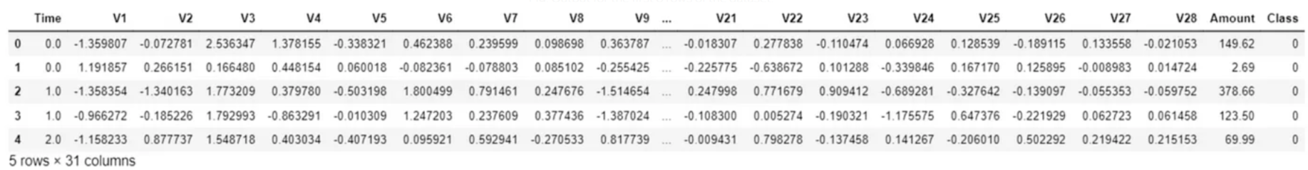
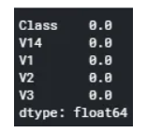
• Features V1, V2, ... V28 are the principal components obtained with PCA
• The only features which have not been transformed with PCA are Time and Amount. Feature Time contains the seconds elapsed between each transaction and the first 5 transaction in the dataset. The feature Amount is the transaction Amount, this feature can be used for example-dependent cost-sensitive learning.
Output of first 5 row of the dataset :
No Missing values in the dataset :

Slide 9
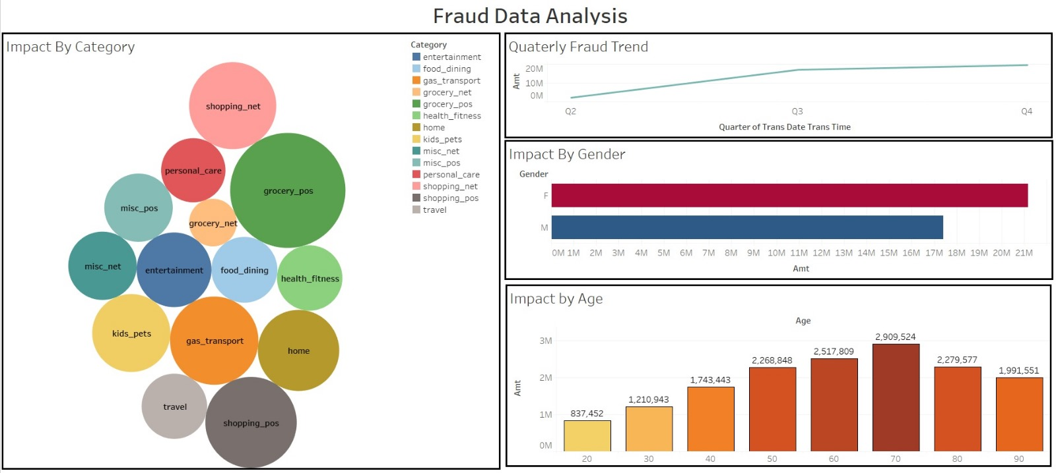
DASHBOARD

Slide 10
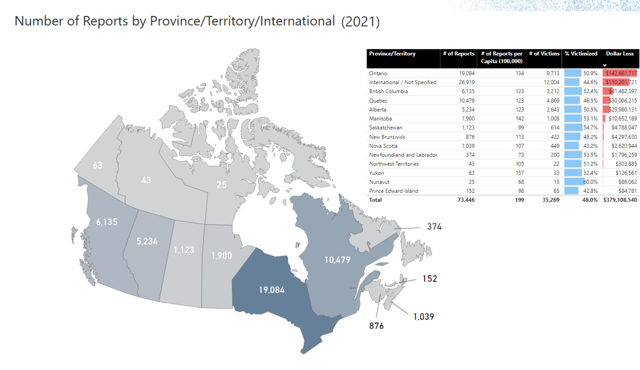
Number of Frauds by Province (Anti-Fraud Centre Canada)

Slide 11
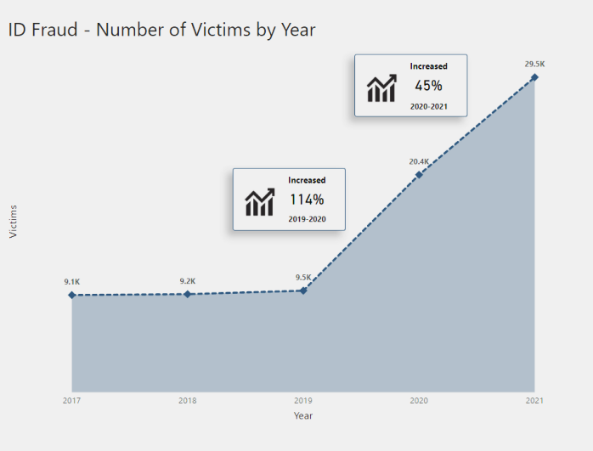
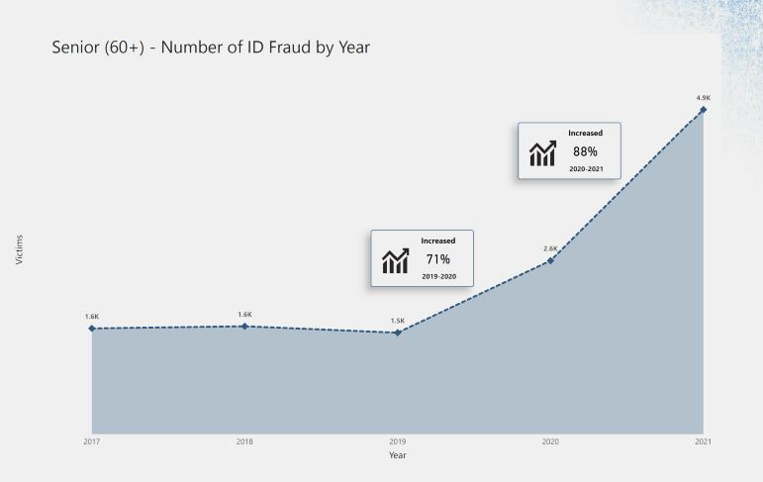
Credit card fraud is a type of identity theft in which fraudsters make transactions or receive cash advances under your name. This can happen with an existing account, through the loss of your actual credit card, account numbers, and PINs, or by opening new credit card accounts in your name.
The two most common reported frauds according to Anti-Fraud Centre Canada are Id frauds and Senior Citizens Id fraud which has observed step increase in past three years.

Slide 12
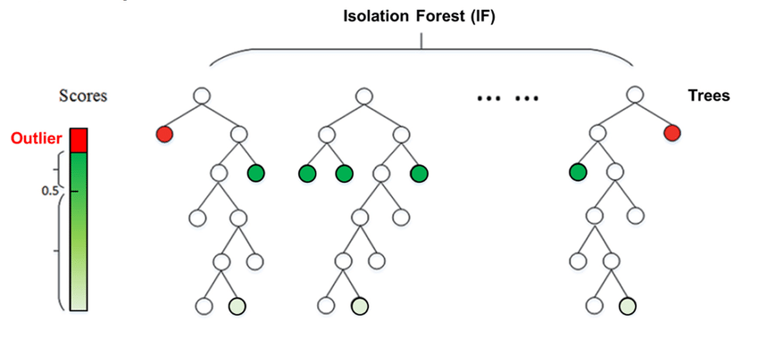
Data Mining Concept/ Method

Slide 13
Data Mining Concept/ Method
Unsupervised Anomaly Detection: Isolation Forest is an unsupervised machine learning technique for detecting anomalies or outliers in a dataset.
Use Cases: It's used in various domains like fraud detection, network security, and quality control in manufacturing. It utilizes decision trees to isolate anomalies by randomly partitioning the data, aiming to find anomalies with fewer splits.
LOF (Local outlier factor Algorithm) considers both the density of the data point and the density of the data point’s immediate surroundings.
One important characteristic of the LOF approach is that the outliers score takes into account the data point’s relative density.
It is possible to assess whether the data point's density is lower than the density of the neighborhood. This scenario suggests the presence of an outlier.

Slide 14
Evaluation from Model
Observations
Isolation Forest detected 73 errors versus Local Outlier Factor detecting 97 errors.
Isolation Forest has a 99.74% more accurate than LOF of 99.65%.
When comparing error precision & recall for 2 models , the Isolation Forest performed much better than the LOF as we can see that the detection of fraud cases is around 27 % versus LOF detection rate of just 2 %.
So overall Isolation Forest Method performed much better in determining the fraud cases.

Slide 15

Recommendation
Regular checks: Evaluate how well the Isolation Forest model detects fraud regularly. Important Features: Determine the characteristics the model believes are essential for detecting fraud. Adjust Threshold: Determine the sensitivity to detecting fraud depending on the number of errors it encounters.

Slide 16

Potential Solutions:
Implement Behavioral Analytics: The use of behavioral analytics can aid in the detection of out-of-the-ordinary trends or changes in a customer's usual purchasing habits.
Enhance Data Security Measures: Strengthening data security measures is crucial to protect sensitive customer information from falling into the wrong hands.
Educate Customers on Fraud Prevention: It is possible to empower customers to identify and report suspicious activities by educating them about common fraud schemes, phishing scams, and best practices for safeguarding their personal and financial information.
Fraud Alerts: Banks may provide customers with the option to receive real-time fraud alerts via SMS, email, or mobile apps, notifying them of potentially suspicious activity.

Slide 17
THANK YOU

